Slide 1
A PICTURE IS WORTH A THOUSAND WORDS

Slide 2
Welcome to our lesson
Teacher: Tran Thi Theu
Class: 6A

Slide 3
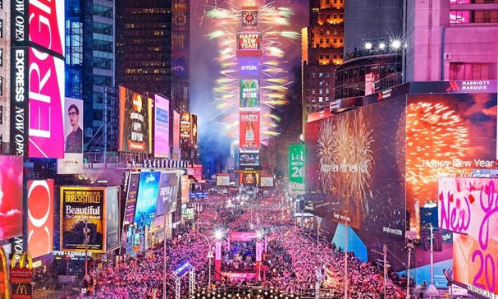
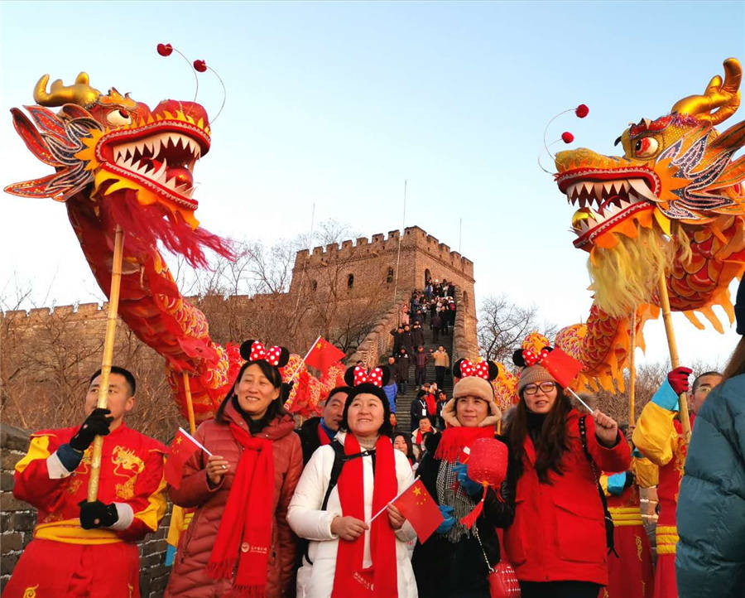
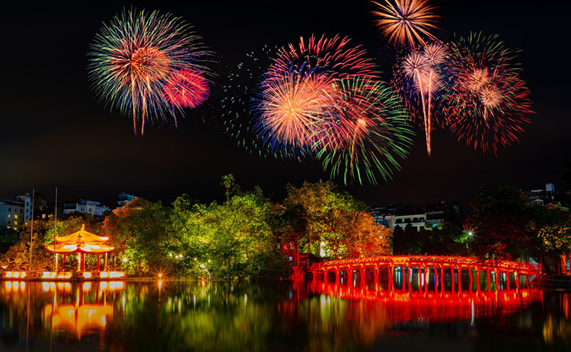
THE USA
CHINA
VIET NAM

Slide 4
Unit 6: Our Tet holiday Period 46: Lesson 5: Skills 1

Slide 5
I. Vocabulary
welcome (v): chào đón
strike (v): điểm giờ ( e.g: clock strikes five)
midnight (n): nửa đêm, 12h đêm
light up (v): thắp sáng
cheer (v): chúc mừng, phấn khởi
custom (n): phong tục
luck (n): sự may mắn
dress (v): wear/ put on: mặc

Slide 6
II. Reading
On New Year’s Day, we dress beautifully and go to our grandparents’ houses. We wish them Happy New Year and they give us lucky money. Then we go out and have a day full of fun.
Wu - China
I learn some customs about Tet from my parents. People give rice to wish for enough food and buy salt to wish for good luck. Dogs are lucky animals but cats are not. A cat’s cry sounds like “poor” in Vietnamese.
Mai – Viet Nam
I often go to Times Square with my parents to welcome the New Year. When the clock strikes midnight, colourful fireworks light up the sky. Everybody cheers and sings.
Russ- the USA

Slide 7
Task 1: Decide who says sentences 1 -5
A. Russ | B. Wu | C. Mai
Statement |  | Who
Dogs are lucky animals. We welcome the New Year at Times Square. Children get lucky money. We give rice to wish for enough food. Children dress beautifully.
C
A
B
C
B

Slide 8
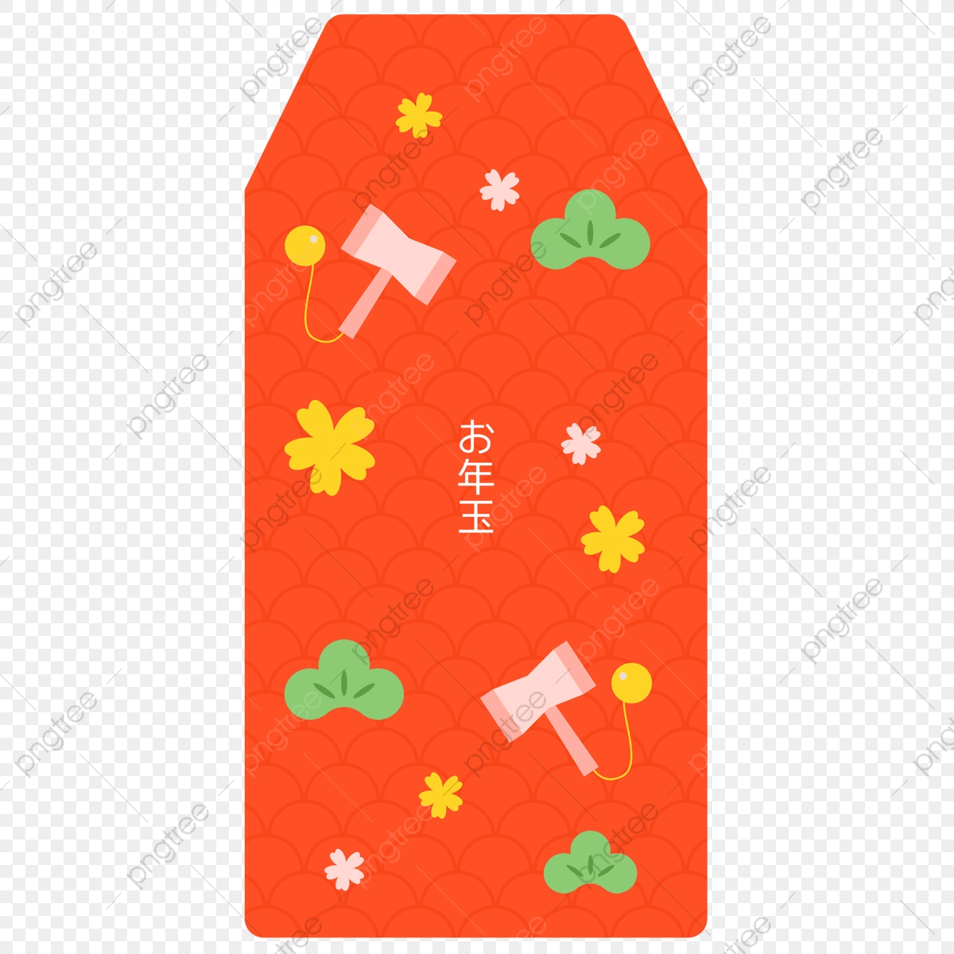
II. Reading
On New Year’s Day, we dress beautifully and go to our grandparents’ houses. We wish them Happy New Year and they give us lucky money. Then we go out and have a day full of fun.
Wu - China
I learn some customs about Tet from my parents. People give rice to wish for enough food and buy salt to wish for good luck. Dogs are lucky animals but cats are not. A cat’s cry sounds like “poor” in Vietnamese.
Mai – Viet Nam
I often go to Times Square with my parents to welcome the New Year. When the clock strikes midnight, colourful fireworks light up the sky. Everybody cheers and sings.
Russ- the USA

Slide 9
II. Reading
On New Year’s Day, we dress beautifully and go to our grandparents’ houses. We wish them Happy New Year and they give us lucky money. Then we go out and have a day full of fun.
Wu - China
I learn some customs about Tet from my parents. People give rice to wish for enough food and buy salt to wish for good luck. Dogs are lucky animals but cats are not. A cat’s cry sounds like “poor” in Vietnamese.
Mai – Viet Nam
I often go to Times Square with my parents to welcome the New Year. When the clock strikes midnight, colourful fireworks light up the sky. Everybody cheers and sings.
Russ- the USA

Slide 10
II. Reading
On New Year’s Day, we dress beautifully and go to our grandparents’ houses. We wish them Happy New Year and they give us lucky money. Then we go out and have a day full of fun.
Wu - China
I learn some customs about Tet from my parents. People give rice to wish for enough food and buy salt to wish for good luck. Dogs are lucky animals but cats are not. A cat’s cry sounds like “poor” in Vietnamese.
Mai – Viet Nam
I often go to Times Square with my parents to welcome the New Year. When the clock strikes midnight, colourful fireworks light up the sky. Everybody cheers and sings.
Russ- the USA

Slide 11
II. Reading
On New Year’s Day, we dress beautifully and go to our grandparents’ houses. We wish them Happy New Year and they give us lucky money. Then we go out and have a day full of fun.
Wu - China
I learn some customs about Tet from my parents. People give rice to wish for enough food and buy salt to wish for good luck. Dogs are lucky animals but cats are not. A cat’s cry sounds like “poor” in Vietnamese.
Mai – Viet Nam
I often go to Times Square with my parents to welcome the New Year. When the clock strikes midnight, colourful fireworks light up the sky. Everybody cheers and sings.
Russ- the USA

Slide 12
II. Reading
On New Year’s Day, we dress beautifully and go to our grandparents’ houses. We wish them Happy New Year and they give us lucky money. Then we go out and have a day full of fun.
Wu - China
I learn some customs about Tet from my parents. People give rice to wish for enough food and buy salt to wish for good luck. Dogs are lucky animals but cats are not. A cat’s cry sounds like “poor” in Vietnamese.
Mai – Viet Nam
I often go to Times Square with my parents to welcome the New Year. When the clock strikes midnight, colourful fireworks light up the sky. Everybody cheers and sings.
Russ- the USA

Slide 13
Task 2: Test your memory! Choose the things which appear in the passage (Poll – maker)
a. lucky money
b. a day full of fun
c. a cat’s cry
d. decorating the house
e. Fireworks
f. saying wishes
g. cheering and singing
h. visiting relatives
√
√
√
√
√
√

Slide 14
II. Reading
On New Year’s Day, we dress beautifully and go to our grandparents’ houses. We wish them Happy New Year and they give us lucky money. Then we go out and have a day full of fun.
Wu - China
I learn some customs about Tet from my parents. People give rice to wish for enough food and buy salt to wish for good luck. Dogs are lucky animals but cats are not. A cat’s cry sounds like “poor” in Vietnamese.
Mai – Viet Nam
I often go to Times Square with my parents to welcome the New Year. When the clock strikes midnight, colourful fireworks light up the sky. Everybody cheers and sings.
Russ- the USA

Slide 15
III. Speaking Task 3: Tell about some activities which you do during Tet.
Example:
I always visit my grandparents at Tet.
I don’t watch fireworks on New Year’s Eve.
1. watch fireworks on New Year's Eve 2. sing when the New Year comes 3. get lucky money 4. go out and have fun 5. dress beautifully 6. buy salt for happiness

Slide 16
Task 4: Discuss what you should or shouldn’t do at Tet
Example: A: We should dress beautifully at Tet. B: I agree. Should we ask for lucky money? C: No, we shouldn't.

Slide 17
Watch videos and give comments

Slide 18
Watch videos and give comments

Slide 21
Useful languages
Vocabulary: affect, occasion, excited, taboo, controversy, discord, bad luck, anything else,…
Expressing:
Oh! That’s wrong.
I agree/ I think so/ me too
Really?
I can’t think…
It’s a good idea.
In particular….
Sure.

Slide 22
What have you learnt today?
Reading about activities and customs about Tet. - Talking about things what children should or shouldn’t do at Tet.
Words/ phrases related to Tet

Slide 23
HOMEWORK
Learn new words by heart
Make sentences with new words
Practice talking about activities at Tet
Do Revision exercises.

Slide 24
Thank you for your attention!

Slide 25
TABLE OF CONTENTS
01
02
03
04
Theory Lesson
Features of This Topic
Here you can describe the topic of the section
Here you can describe the topic of the section
Recommendations
Practical Exercises
Here you can describe the topic of the section
Here you can describe the topic of the section

Slide 26
Warm - up
List some things and activities at Tet

Slide 27
—SOMEONE FAMOUS
“This is a quote, words full of wisdom that someone important said and can make the reader get inspired.”

Slide 28
AWESOME WORDS

Slide 29
FEATURES OF THE TOPIC
Venus
Jupiter
Mars
Saturn
Venus is the second planet from the Sun
It’s the biggest planet of them all
Despite being red, Mars is a cold place
Saturn is a gas giant and has rings

Slide 30
EXAMPLES
Mars
Neptune
Jupiter
Despite being red, Mars is actually a very cold place
Neptune is the farthest planet from the Sun
Jupiter is a gas giant and the biggest planet of them all

Slide 31
THIS IS A GRAPH
Mars
Jupiter
Despite being red, Mars is actually a very cold place
Jupiter is a gas giant and the biggest planet of them all
To modify this graph, click on it, follow the link, change the data and paste the new graph here

Slide 32
WHAT’S IN THE FUTURE?
2022
2023
2024
2025
Venus has a beautiful name
Mercury is the smallest planet
Jupiter is the biggest planet
Mars is actually a very cold place

Slide 33
WHAT ABOUT COLOURS?
RED
30%
ORANGE
50%
YELLOW
20%
Saturn is a gas giant and has rings
Earth is the planet where we live on
It’s a gas giant and the biggest planet

Slide 34
TRUE OR FALSE?
 | QUESTION 1 | QUESTION 2 | QUESTION 3 | QUESTION 4
 | Is Mars a very cold place? | Is Jupiter the biggest? | Is Saturn a gas giant too? | Is Earth where we live on?
TRUE
FALSE

Slide 35
SOME CHINESE ZODIAC ANIMALS
2016
2019
2017
2020
2018
2021
Venus has a beautiful name
Jupiter is the biggest planet
Mercury is the smallest planet
Despite being red, Mars is a cold place
Saturn is the only ringed planet
Earth is the planet where we live on

Slide 36
LET’S PAINT
Color this awesome ox

Slide 37
READY TO PRINT
Do you want this ox mask? You just have to copy and paste this image on another page, print it and have fun!

Slide 38
CAN YOU BUILD IT?
Build this ox using the following figures:

Slide 39
DESKTOP SOFTWARE
You can replace the image on the screen with your own work. Just delete this one, add yours and center it properly

Slide 40
TABLET APP
You can replace the image on the screen with your own work. Just delete this one, add yours and center it properly

Slide 41
MOBILE WEB
You can replace the image on the screen with your own work. Just delete this one, add yours and center it properly

Slide 42
THANKS!
Do you have any questions?
addyouremail@freepik.com
+91 620 421 838
yourcompany.com
Please keep this slide for attribution.

Slide 43
ALTERNATIVE RESOURCES

Slide 44
RESOURCES
VECTOR
Wildlife Icon Pack
Chinese Year Icon Pack
Animals Icon Pack
World map professional infographic
Technology elements background in flat style
Chinese new year calendar in flat design
Chinese new year in flat design
Chinese new year in paper style
Chinese new year in flat design
Golden chinese new year 2021
Golden chinese new year illustrated
Golden chinese new year 2021
PHOTO
Chinese new year concept with copy space
Beautiful chinese new year concept

